Slide 1
Burnout: The Contagion & What We Can Do About It
Tina Shah MD MPH
CEO, TNT Health Enterprises
Copyright © TNT Health Enterprises, 2021
Notes:
Important background context:
-1700 proviers, of which 800 docs [21% pcps, 57% specialists]
- 5/2021 EMR rollout EPIC
Dealing with whiplash from HCW are heroes to harassment over masks
pts who delayed care coming back, and sicker now
Too many AWV
Feeling like a checkbox person
Increasing rates of MD turnover
Has been some where monthly emails on individ targeted resources must haves and next level like Farley email
‘smallbany’ everyone knows each other
Providers, APPs is the terminology
What does it look like when we reach the 4th aim
Acknowledge and normalize what clinicians are feeling
Introduce and relate concepts i.e., burnout, depression, moral injury
Frame burnout as a problem that mandates organizational solutions and case studies to show how other physician groups are tackling burnout
Catalyze interest among listers to work on wellbeing and kickoff wellbeing work across IHANY network

Slide 2
Goals
Understand that burnout is highly prevalent among providers
Define burnout and compare it to other related terms
Understand that burnout is a problem that mandates systems solutions
Arm you with a roadmap and solutions to consider as you accelerate well-being work at IHANY
Copyright © TNT Health Enterprises, 2021

Slide 3
Conflicts & Disclosures
None.
Copyright © TNT Health Enterprises, 2021

Slide 5
Question: Overall, based on your definition of burnout, how would you rate your level of burnout?
Copyright © TNT Health Enterprises, 2021

Slide 6
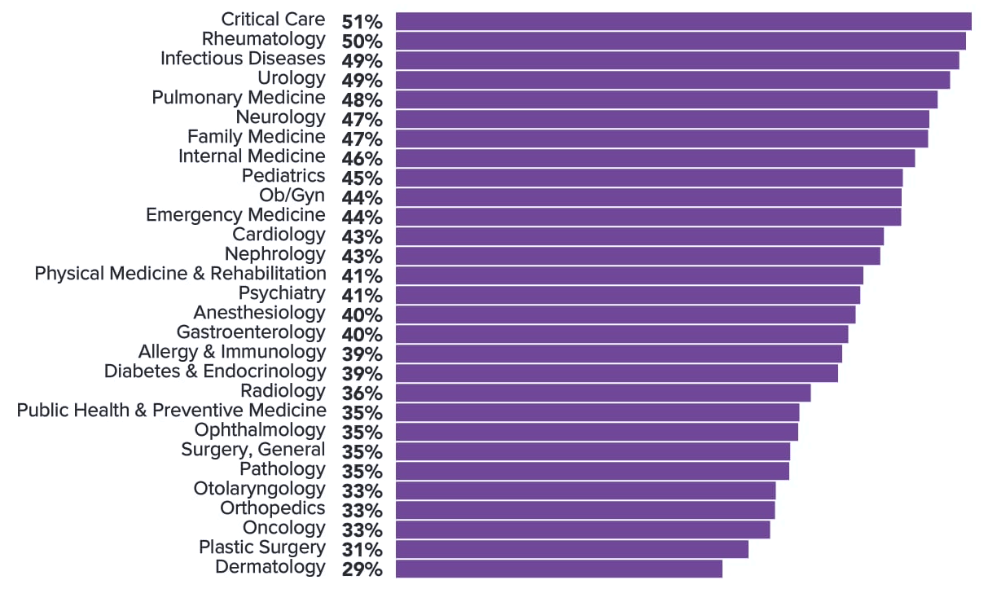
Rates of physician burnout are > 2X that of the general population
Who is at increased risk?
Female
Younger
Minoritized
Drybye et. al. NAM Perspectives 2017
Medscape Nat’l Physician Burnout and Suicide Report 2021
Copyright © TNT Health Enterprises, 2021

Slide 7
Burnout is an Occupational Condition
An occupational condition due to a chronic mismatch between job demands and resources
Having at least one of the following symptoms:
emotional exhaustion
Depersonalization
lack of personal accomplishment
Z 73.0
Malach et. al. Maslach Burnout Inventory Manual (4th Ed)
Copyright © TNT Health Enterprises, 2021

Slide 8
Differentiating Burnout
Burnout | A syndrome of emotional exhaustion, depersonalization, and reduced personal accomplishment occurring from chronic workplace stress. The term burnout should not be applied to describe experiences in other areas of life
Depression | A prolonged episode of at least 2 weeks characterized by depressive mood or anhedonia occurring most of the day, nearly every day. Context-independent
Engagement | A sense of purpose that is evident in their display of dedication, persistence and effort in one’s work, or overall attachment to their organization and. its mission.
Moral distress | A psychological response to morally challenging situations. This can be a result of a situation in which a healthcare professional is prohibited from taking the morally correct course of action or in a situation where there is moral uncertainty regarding decisions surrounding patient care
Professional Wellness | A function of being satisfied with one’s job, having a high-quality working life, and finding professional fulfillment in one’s work, as a result of constructive conditions in the workplace
Resilience | Ability of a person, community, or system to withstand, adapt, recover, rebound, or even grow from adversity, stress, or trauma
Copyright © TNT Health Enterprises, 2021

Slide 9
Drybye et. al. NAM Perspectives 2017
Toker et. al. Psychosomatic Medicine 2012
Copyright © TNT Health Enterprises, 2021

Slide 10

Cognitive Load Theory
2021
GOAL
Intrinsic Load
MENTAL RESERVE for executive functioning
Intrinsic Load
Germaine Load
Extraneous Load
Germaine Load
Extraneous Load
Copyright © TNT Health Enterprises, 2021

Slide 11
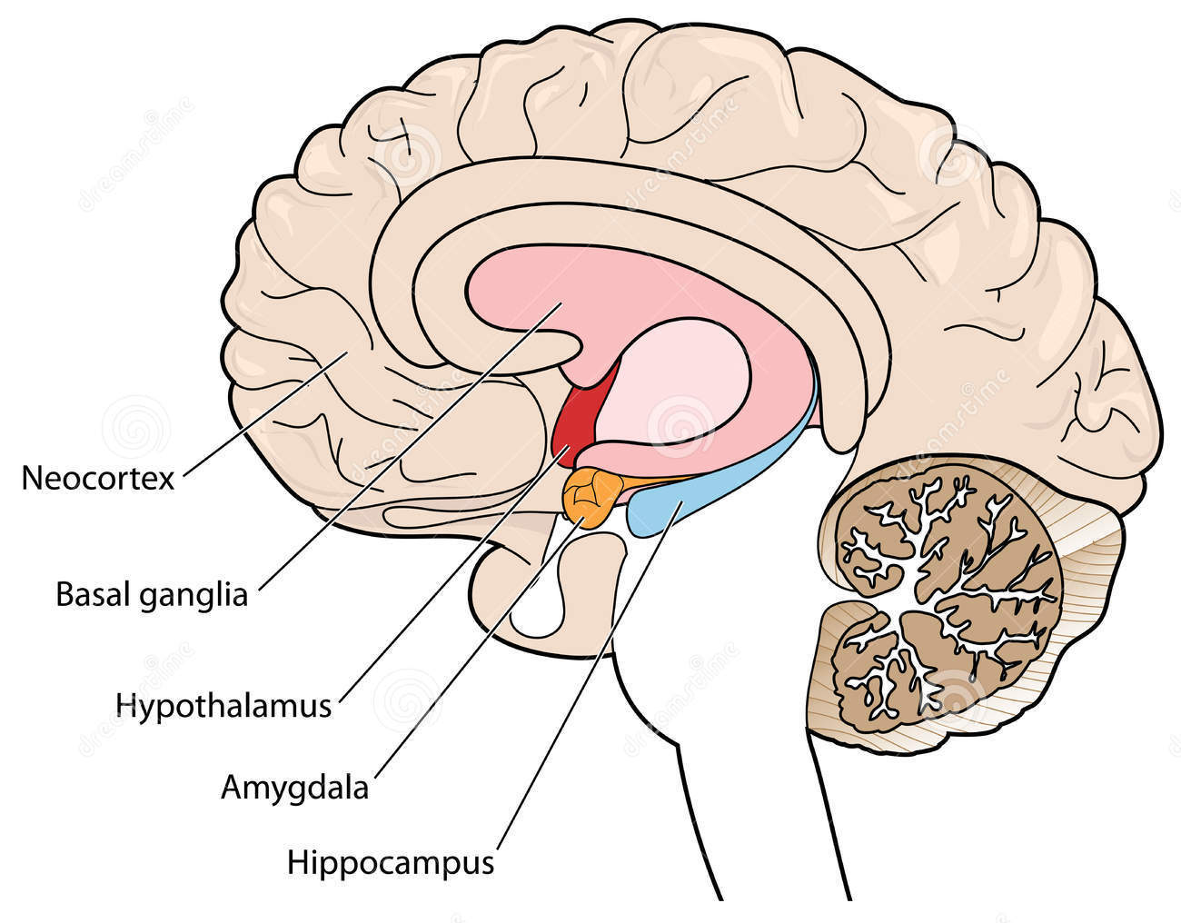
Burnout Causes Biologic Changes in the Brain
Thinning of the Pre-frontal Cortex
↓ ability to focus, quality of medical decision-making
Decreased grey matter of Basal Ganglia from excess glutamate
↓ fine motor control
Amygdala enlarges
↑ reactivity to stress
Hippocampus shrinks
↓ short-term memory, then long-term memory
Michel et. al. Assn. for Psychological science 2016
Savic et. al. Cerebral Cortex 2015
Alkadhi et. All ISRN Physiology 2013
Golkar A et al PLoS ONE 2014
Copyright © TNT Health Enterprises, 2021

Slide 12
Provider Wellbeing Affects Every. Single. Aim.
MD + RN emotional exhaustion linked to increased patient mortality in the ICU
Increased medical errors among surgeons
↑ Provider
Wellbeing
↑ Outcomes
Increased turnover
Decreased productivity
More referrals/tests*
Decreased patient satisfaction
Greater explicit and implicit racial biases among trainees
↑ Patient
Experience
↓ Costs
Institute for Healthcare Improvement
Quadruple Aim
Welp et. al. Front. Psychol 2015
Shanafelt et. al. Annals of Surgery 2010
Dyrbye et. al. JAMA open 2019
Shanafelt et. al. J. Amer Coll. Surgeons 2010
Bachman et. al. Social Science and Medicine 1999
Copyright © TNT Health Enterprises, 2021

Slide 13
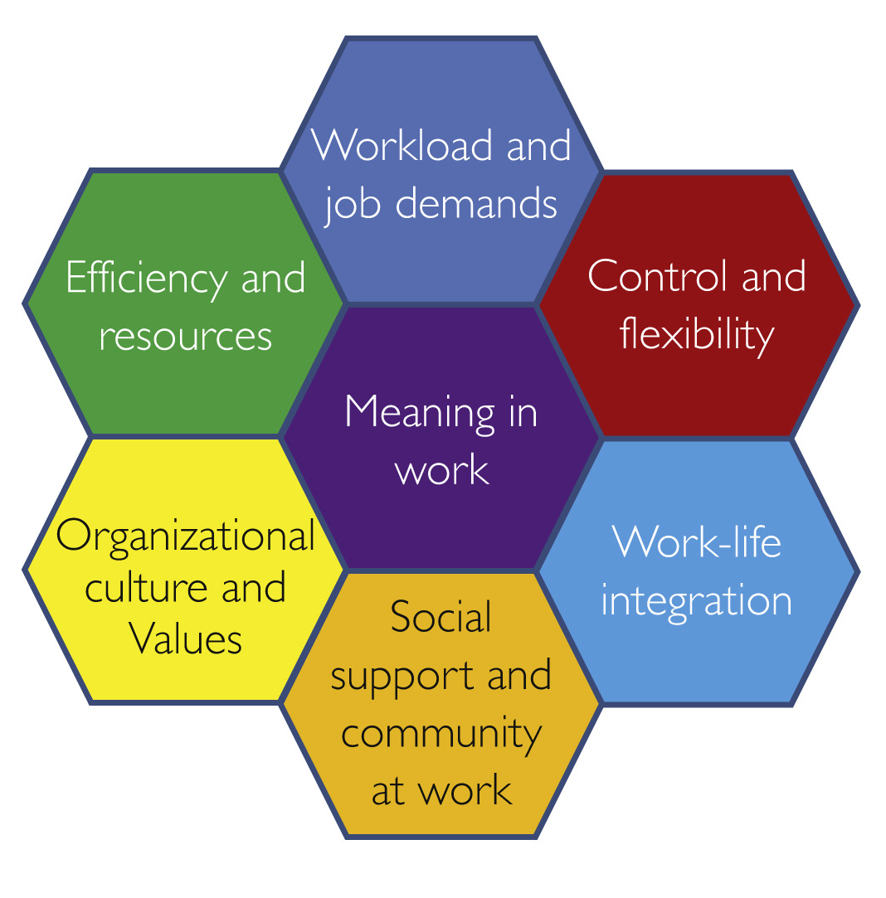
Drivers of Burnout
Shanafelt, Noseworthy Mayo Clin Proc 2016
Copyright © TNT Health Enterprises, 2021

Slide 14
Question: Which would help most to increase your wellbeing?
Copyright © TNT Health Enterprises, 2021
Notes:
- recognition for your work - Increased control and autonomy - Increased fairness and transparency - programs to reduce stress - Improved tech and workflows - a Giants miracle

Slide 15
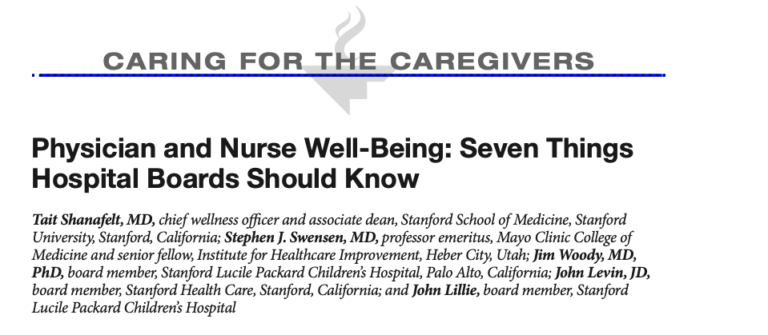
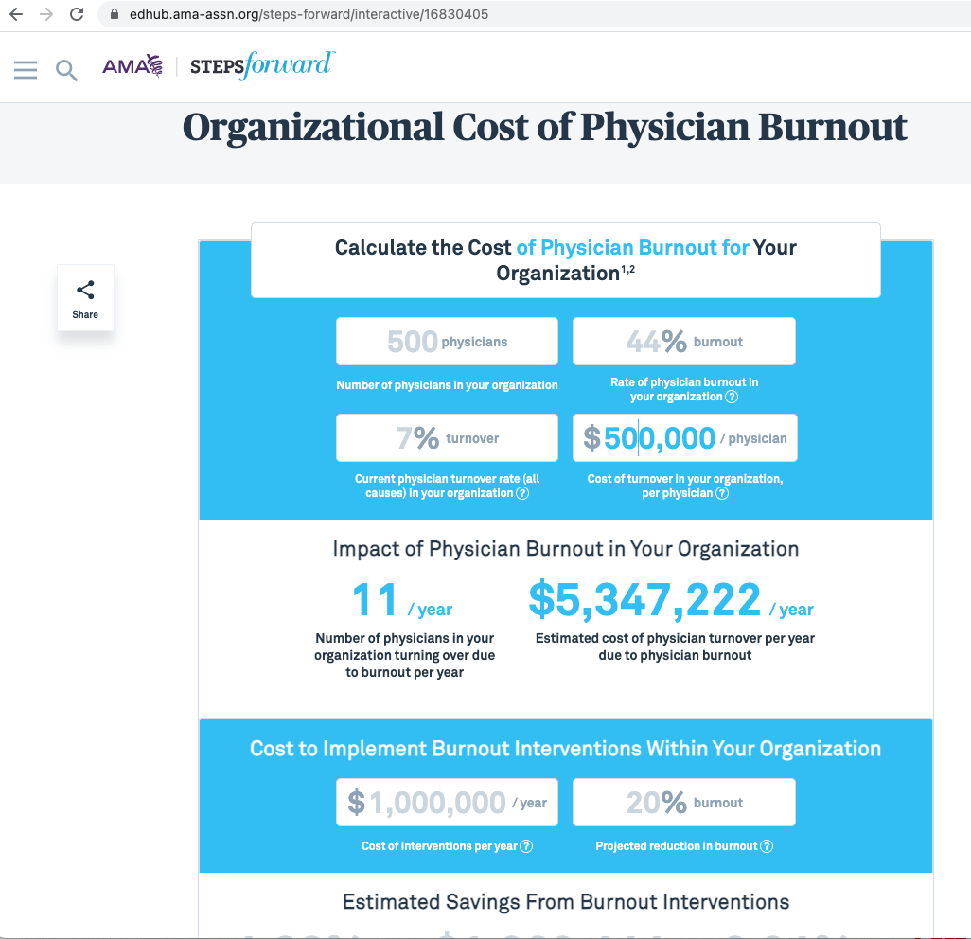
What We Know:
Providers’ Distress costs organizations a lot of money
Different disciplines and occupations have unique needs
Evidence and tactics are available to address the problem, and should focus on system-level
Interventions work
Shanafelt et. al. ACHE 2018
Shanafelt et. al. JAMA IM 2019
Copyright © TNT Health Enterprises, 2021

Slide 16
Individual Resiliency is NOT the problem
(n=4705) US physicians compared to workers in other fields (n=5198)
Physicians had higher personal resilience, even after adjusting for age, sex, and hours worked
Each 1-point increase in resilience was associated with a 36% lower odds of burnout
West et. al. JAMA Open 2020
Copyright © TNT Health Enterprises, 2021

Slide 17



Copyright © TNT Health Enterprises, 2021

Slide 18
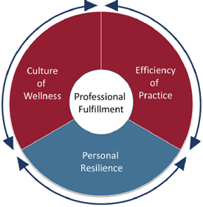
Taking Action: A Roadmap for Well-being
The Stanford WellMD Model
STEP 1: Engage Senior Leadership
STEP 2: Track the Business Case for Well-Being
STEP 3: Resource a Wellness Infrastructure
STEP 4: Measure Wellness and the Predictors of Burnout Longitudinally
STEP 5: Strengthen Local Leadership
STEP 6: Develop and Evaluate Interventions
STEP 7: Improve Workflow Efficiency and Maximize the Power of Team-Based Care
STEP 8: Reduce Clerical Burden and Tame the EHR
STEP 9: Support the Physical and Psychosocial Health of the Workforce
Copyright © TNT Health Enterprises, 2021

Slide 19
Foundational During COVID-19: Must Do
Peer support Program
Robust Mental Health Services
Trauma trained professionals
Training leaders in psychological first aid
Measure, track and make well-being a key leadership responsibility
Round on your people
System approach to address administrative burdens (G.R.O.S.S.)
Copyright © TNT Health Enterprises, 2021

Slide 20




Peer Support Programs
Care for the Caregiver
COMPASS: Dining Groups
Helping Healers Heal
Godfrey, Kuhn AMA Steps Forward 2020
West et. al. JAMA Intern Med 2014
Trinity College Dublin White Paper 2019
Copyright © TNT Health Enterprises, 2021

Slide 21
Foundational Programs During COVID-19: Must Do
Peer support Program
Robust Mental Health Services
Trauma trained professionals
Training leaders in psychological first aid
Measure, track and make well-being a key leadership responsibility
Round on your people
System approach to address administrative burdens (G.R.O.S.S.)
Copyright © TNT Health Enterprises, 2021

Slide 22




Measure, track & make well-being a key leadership responsibility
Measuring Well-being:
Mini-Z
Maslach Burnout Inventory
Stanford Well-being Index
NASA Task Load Index
The National Academy of Medicine’s well-being hub has side-by-side comparisons of tools
Copyright © TNT Health Enterprises, 2021

Slide 23
Foundational Programs During COVID-19: Must Do
Peer support Program
Robust Mental Health Services
Trauma trained professionals
Training leaders in psychological first aid
Measure, track and make well-being a key leadership responsibility
Round on your people
System approach to address administrative burdens (G.R.O.S.S.)
Copyright © TNT Health Enterprises, 2021

Slide 24


G.R.O.S.S. Getting Rid of Stupid Stuff
Led by the Chief of Quality to fix meaningless EHR documentation:
Never meant to occur
Needed but inefficient
Required but not understood
Impact:
Provider direct input in workplace
Reduction in low value tasks/getting time back
Copyright © TNT Health Enterprises, 2021

Slide 25
Taking Action: A Roadmap for Well-being
The Stanford WellMD Model
STEP 1: Engage Senior Leadership
STEP 2: Track the Business Case for Well-Being
STEP 3: Resource a Wellness Infrastructure
STEP 4: Measure Wellness and the Predictors of Burnout Longitudinally
STEP 5: Strengthen Local Leadership
STEP 6: Develop and Evaluate Interventions
STEP 7: Improve Workflow Efficiency and Maximize the Power of Team-Based Care
STEP 8: Reduce Clerical Burden and Tame the EHR
STEP 9: Support the Physical and Psychosocial Health of the Workforce
Copyright © TNT Health Enterprises, 2021

Slide 26
STEP 7: Improve Workflow Efficiency and Maximize the Power of Team-Based Care
Integrating telemedicine daily clinic schedules
In-basket message volume
Pre-visit
Labs
Annual Wellness Visits
Synchronized Annual Rx Renewal
Optimizing
Rooming
VA Study: 1.5 hours PCP time saved/wk by reducing low value messages
Bookend video visits
Centralize virtual care check-ins
Designate a virtual superuser
Shah et. al. BMJ 2019
Zheng et. al. JAMIA 2010
Sinsky, interview 2021
AMA Steps Forward
Copyright © TNT Health Enterprises, 2021

Slide 27
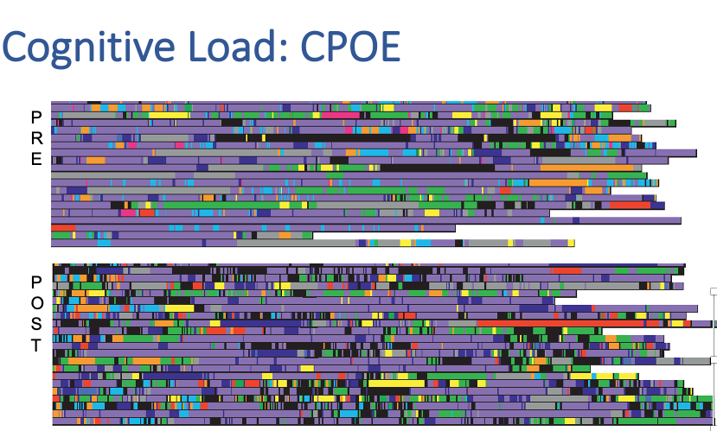
STEP 8: Reduce Clerical Burden and Tame the EHR
2021 E/M coding guidelines update impact on note length/time
Allow computerized order entry (CPOE)to be performed by clerical and clinical staff
Allow clerical and clinical staff to receive verbal orders (meds by clinical staff only)
Shah et. al. NAM Perspective 2020
Zheng et. al. JAMIA 2010
Sinsky, interview 2021
Copyright © TNT Health Enterprises, 2021

Slide 28


Slide 29
Thank you!
Additional Resources:
AMA Steps Forward Modules
National Academy of Medicine Clinician Well-being Knowledge Hub
Copyright © TNT Health Enterprises, 2021

Slide 30
Q & A

Slide 31
CME Credit
Complete evaluation immediately after the event: https://bit.ly/3pgVWyy
If you watched the event as a group, please make sure that we have the following from each participant:
Email IHANYNetworkMgmt@sphp.com immediately after the event so that we can count you as a participant
Include your Full Name with Title/Credential (MD/DO, NP, PA)
Please provide this information to claim your CME credits. We will add you to the attendance list and send you a link to the on-line evaluation form.
Notifications received after 9 am on October 26, 2021 will not be accepted
You will receive your CME certificate via email.
Copyright © TNT Health Enterprises, 2021

Slide 32
Supplemental Slides
Copyright © TNT Health Enterprises, 2021

Slide 33

STEP 2: The Average Cost of Burnout is $500K/physician
Copyright © TNT Health Enterprises, 2021

Slide 34
The Four Drivers of Burnout
Inability to provide quality care
Inefficient processes
Poor Recognition
Lack of Input
Copyright © TNT Health Enterprises, 2021

